Slide 1


Investments in transitive economics of Ukraine
Done it
student of group 015, 1st year
Alina Serhiivna Burlak

Slide 2










Content
Introduction
Investments in the transition economy
The state of the transitional
economy of Ukraine
The role of the state in investing
in the transition economy
Advantages of investing in
a transition economy
Infrastructure as a factor of
attractiveness for investors
Risks of investing in a
transition economy
Sectors of the economy that
need investment
Transitional economy:
definitions and features

Slide 3

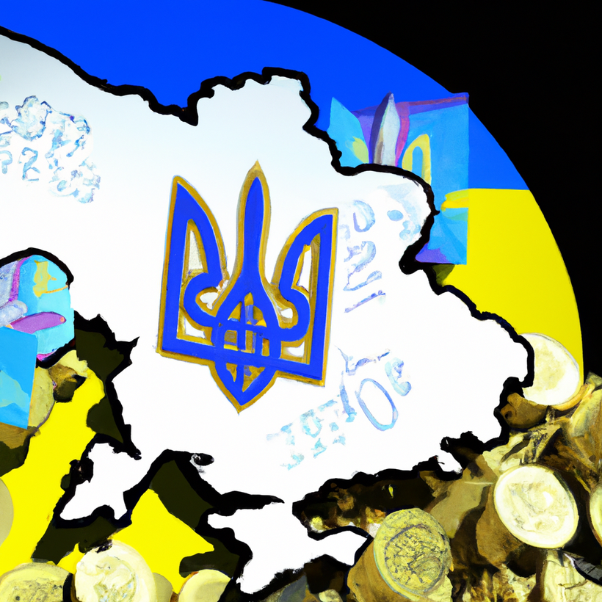
Introduction
Ukraine's transition economy is complex and requires a lot of attention. Investments can become a key factor for the development of the country's economy.
Investing in a transition economy can be risky, but with the right approach, it can bring significant benefits to both investors and the country as a whole.

Slide 4

The state of the transitional economy of Ukraine
Ukraine is a country with a transition economy, which means that it is going through a transition from a communist system to a market economy.
Despite some positive developments, such as a decrease in inflation and an increase in GDP, Ukraine still faces numerous challenges, such as corruption and lack of competitiveness.

Slide 5

Advantages of investing in a transition economy
Investing in transition economies can have significant potential for earnings growth. The country has great potential for development in areas such as agriculture and information technology.
Investment can also help reduce corruption and increase a country's competitiveness, which can lead to an increased investment climate and promote business development.

Slide 6
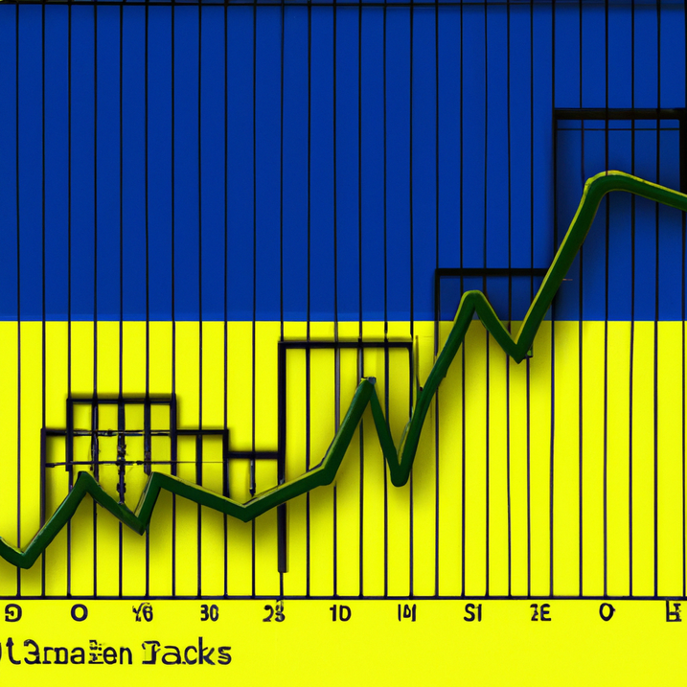
Risks of investing in a transition economy
Investing in economies in transition may involve risks, including political instability and a weak legal system.
Investing in transition economies can be profitable, but there may be issues with indemnification and investment security. It takes the right approach and market research.

Slide 7
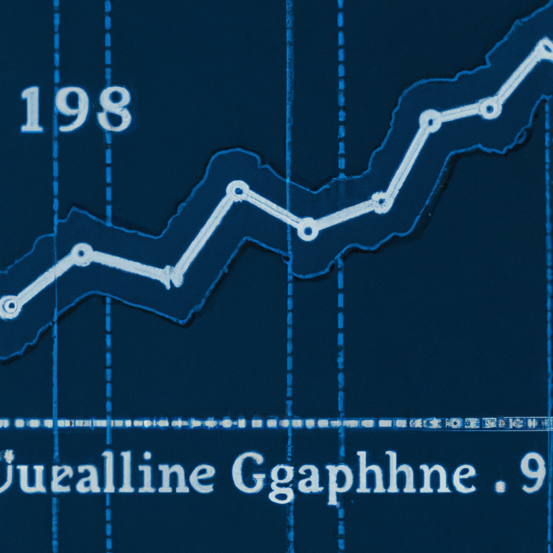
Transitional economy: definitions and features
A transition economy is the economy of a country that is transitioning from a planned economy to a market economy. Ukraine is an example of a country with a transition economy, as it made such a transition in the 1990s.
The peculiarities of the transition economy are that it is characterized by a low level of market development, weak institutions, instability and insufficient competitiveness.

Slide 8
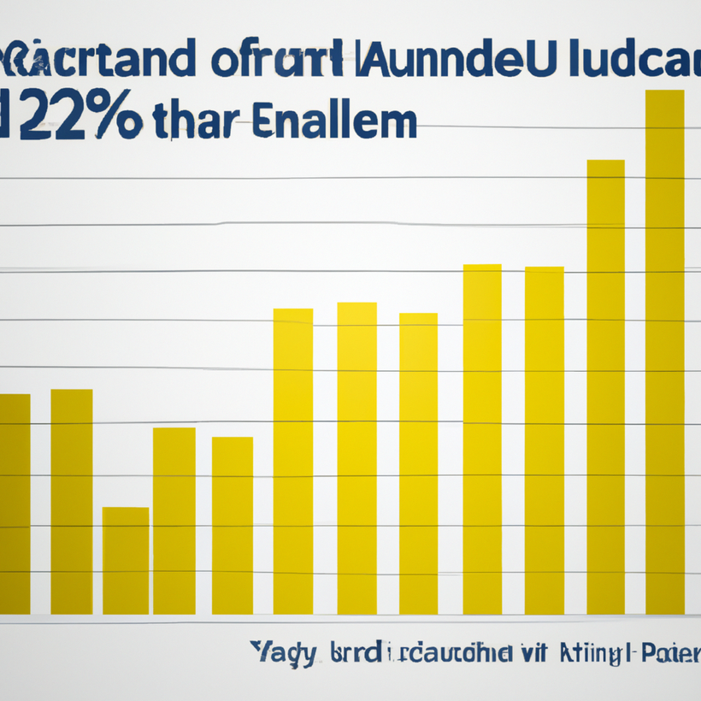
Investments in the transition economy
Investments are important for the development of a transition economy. These can be foreign and domestic investments. Foreign investors bring new technologies and know-how, while domestic investors contribute to the creation of jobs and the development of economic sectors.
Investing in transition economies involves risks such as political instability, corruption and unpredictability of legislation. Before making investment decisions, it is necessary to research the risks and prospects of economic development.

Slide 9
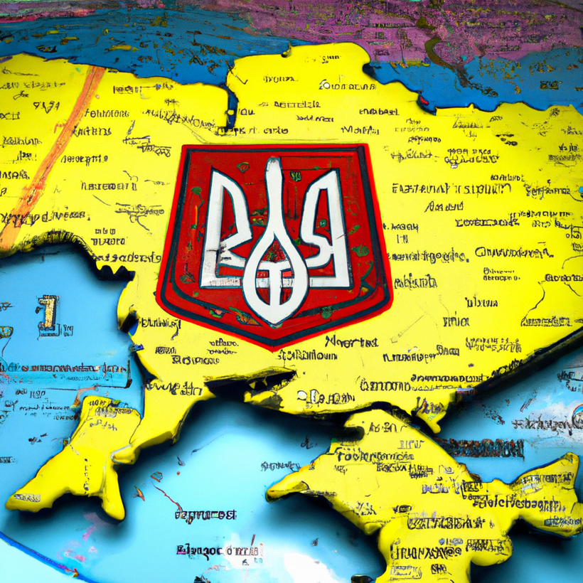
Result
Investing in the transitional economy of Ukraine can be profitable, but requires careful research and the right approach.
The country has significant potential for development in various sectors, and investment can help reduce corruption and increase the country's competitiveness. Despite this, investors should be careful and considerate when choosing projects and comply with all rules and laws.

Slide 10
Thank you for your attention!

