Slide 1
#kkreativa

Slide 2

REALISTIC
R&D
result
risk
Research
Artur
REVENUE
reputation

Slide 3

ENTERTAINMENT
ENGAGEMENT
effective
Alexandra
Emotions
expert
Ethical
Efficient
Empowering

Slide 4
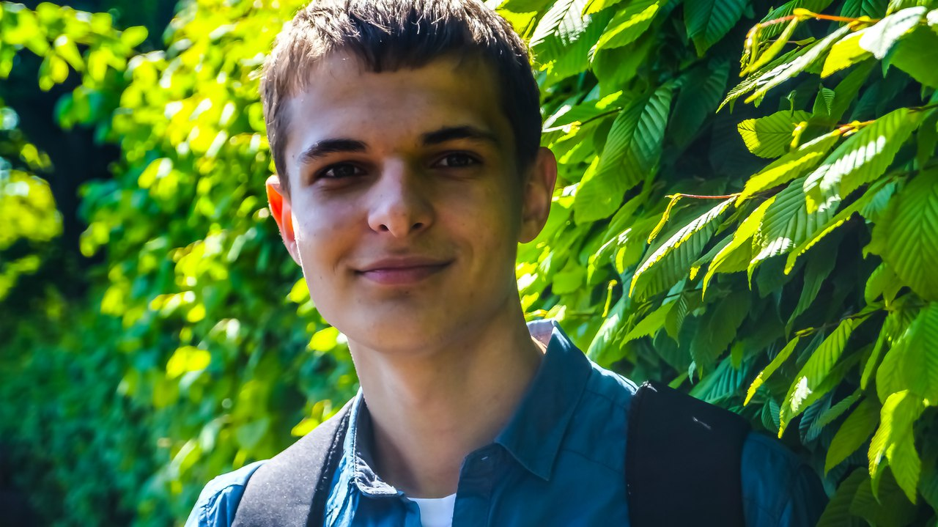
identity
INFORMATION
I
IMPACT
Intellectual
Innovative
Dima
INVENTORY
imige
INTELLIGENT
Ideas
Identity
Idealistic

Slide 5

maintains
mentor
М
magic
market
MARKETING
Mix
Olga
Motive
matter
method
MANAGEMENT
model
media
MATTER
Motive
MAKING
MATTER

Slide 6
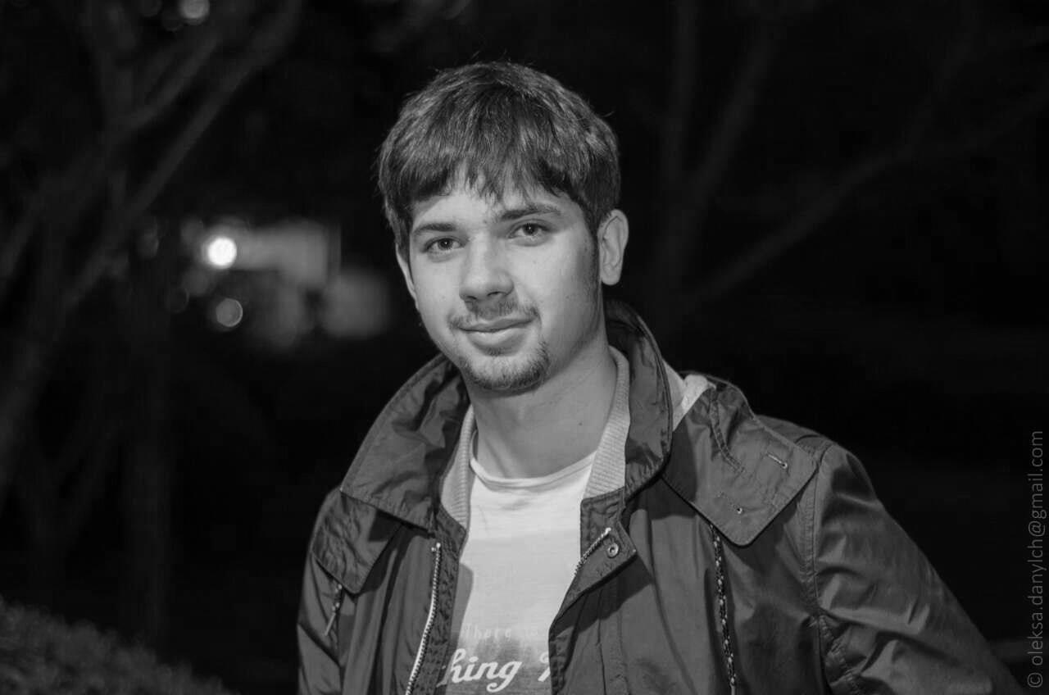
X
X-men
Xmas
Zhenya
XENON

Slide 7





М
I
X
E
R

Slide 8


MI ER
Explore.
Create.
Enjoy.

