Slide 1


Slide 2

The Internet has already entered our ordinary life. Everybody knows that the Internet is a global computer network, which embraces hundred of millions of users all over the world and helps us to communicate with each other.
I'm going to talk about the Internet Facts.

Slide 3
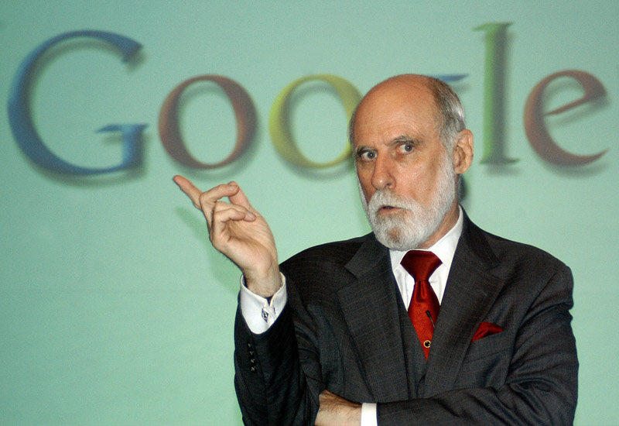
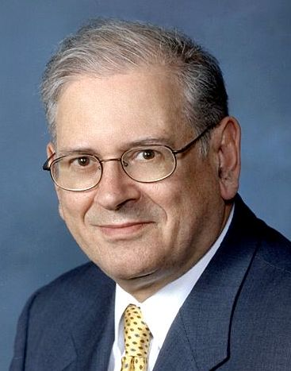
Internet Facts
1. The first attempt to connect two computers and allow them to communicate with one another was made by researchers at the University of California in Los Angeles and the Stanford Research Institute on 20 October 1969.
2. The first people to coin the term 'internet' were two scientists, Vinton Cerf (known as 'father of the Internet‘) and his collaborator Bob Kahn, who in 1974 devised a means by which data could be transmitted across a global-network of computers.

Slide 4
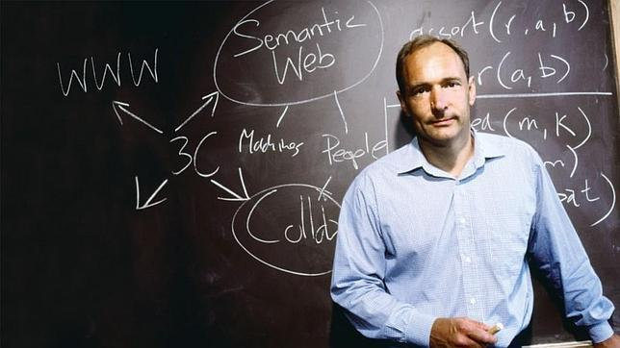
Internet Facts
3. An Oxford graduate, Tim Berners-Lee, set up the first 'www server' (a Server receives and sends messages) to store the archive of the European Particle Physics Laboratory in Switzerland.
4. The inventor of the modern world wide web, Tim Berners-Lee, was knighted by Queen Elizabeth.
5. Mr. Berners-Lee uploaded the first image to the internet. It is of a joke band of women from the nuclear research lab CERN.
6. The first e-mail ever sent was in 1972 between computers in two American universities.

Slide 5

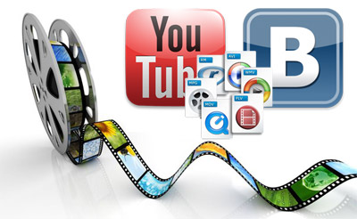
Internet Facts
7. A U.S. journalist faces 105 years in jail for posting a link on the web.
8. 15% of American adults do not use the Internet.
9. Researchers are debating on adding Internet addiction to the list of mental disorders.
10. 9 million adults in Britain have never used the internet.
11. Psychologists examined Internet trolls and found that they are "narcissistic, psychopathic, and sadistic".
12. 50% of Internet users will quit waiting for a video to load after 10 seconds.
13. The first YouTube video was uploaded April 23, 2005. It’s called “Me at the zoo,” and features Jawed Karim, one of the founders, at the San Diego Zoo.

Slide 6

Internet Facts
14. It took only 5 years for the internet to reach a market audience of 50 million users.
15. The Philippines has the slowest Internet speed in the entire Southeast Asian region with an average speed of 3.54 Mbps.
16. Internet Users send 204 million emails per minute.
17. China has more internet users on mobile devices than on PCs.
18. 70% of all the emails sent are spam.
19. One third of Italians have never used the Internet.
20. The "Fi" in "WiFi" doesn't mean anything. The creators just called it that because it rhymed with "HiFi“.
21. By the end of 1993, there were only 623 websites on the World Wide Web.
22. Only 37.9% of people have access to the Internet once a year or more.

Slide 7

Internet Facts
23. A single Google query uses 1 000 computers in 0.2 seconds to retrieve an answer.
24. Chinese social network Sina Weibo has 280.8 million users.
25. Twitter has 250 million users.
26. The first website is still online.
27. The world record for fastest texter is held by a Brazilian teenager.
28. The first spam email was sent in 1978 over ARPNET by a guy named Gary Thuerk. He was selling computers.
29. The first registered domain was symbolics.com.
30. Today, the Internet is 8354 days old.

Slide 8
VOCABULARY
Embrace – включать в себя, охватывать
to coin the term – придумали термин
Devise - разработать
Transmitted – передаваемый, посланный
Nuclear – ядерный
Jail – тюрьма
Mental – психическое
Entire – весь, целый
Rhymed - рифмованный

